Slide 1
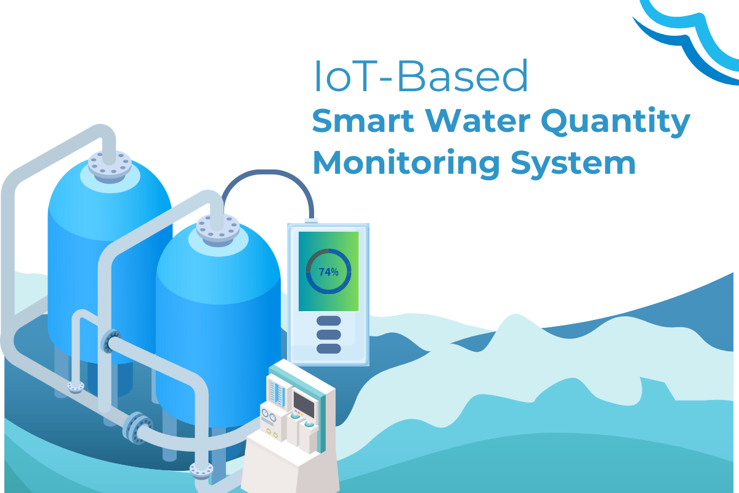
Water Tank Monitoring System

Slide 2
MEET THE TEAM
IT24101551 | Kuyilini. T
IT24103103 | Nithushan. U
IT24102004 | Mugesh. R
IT24100945 | Liyanage S.L.U
IT24103059 | Premasekara J. J
IT24100267 | De Silva N.R. P

Slide 3





CONTENT
05. Methodology
06. Evaluation Method
07. Conclusion
08. References
01. Introduction
02. Problem &
Motivation
03. Aim & Objectives
04. System Overview

Slide 4
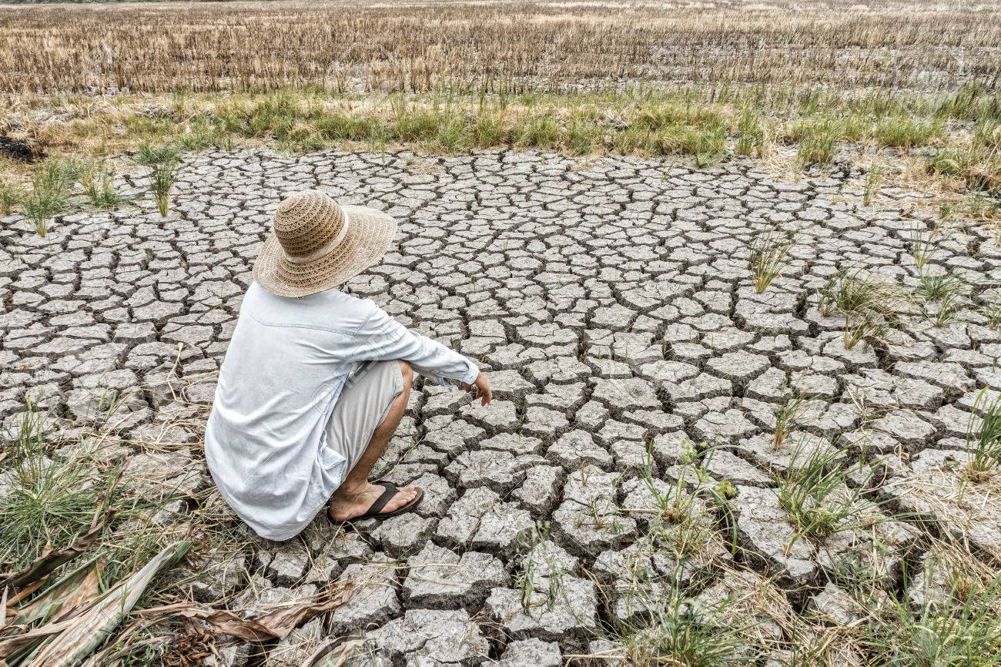
01. Introduction

Slide 5
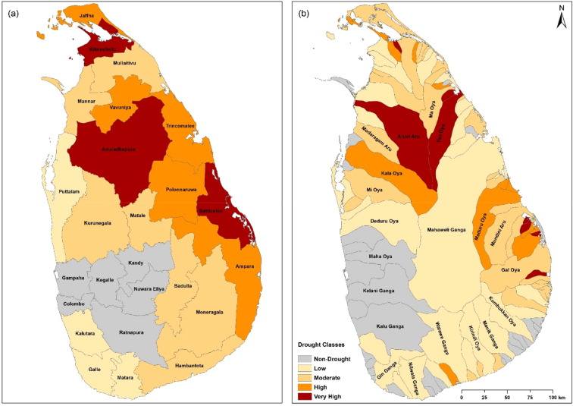
Agricultural drought monitoring in Sri Lanka using multisource satellite data

Slide 6
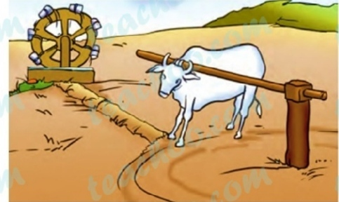
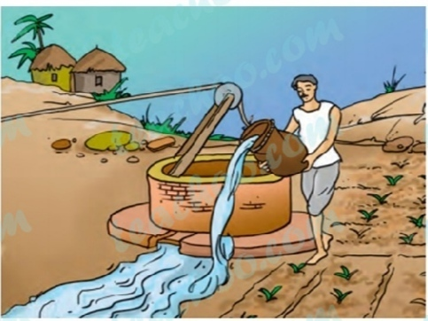
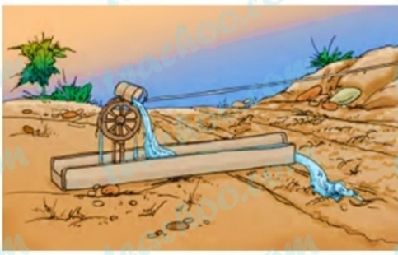
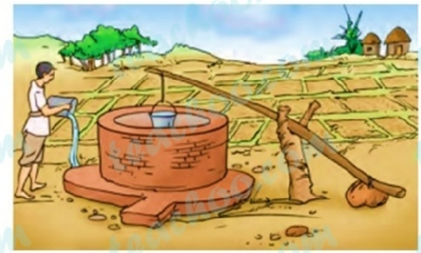
Traditional irrigation system

Slide 7

"Not even a drop of water that comes from the rain must flow into the ocean without being made useful to man"

Slide 8
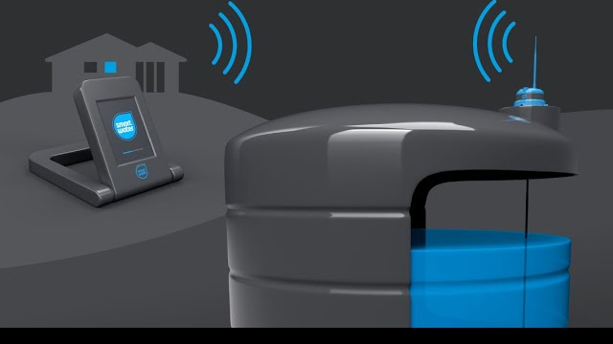
HYDRATION
The intelligent Water Tank Monitoring System

Slide 9




Managing rainwater
Optimizing distribution
Preventing water wastage

Slide 10
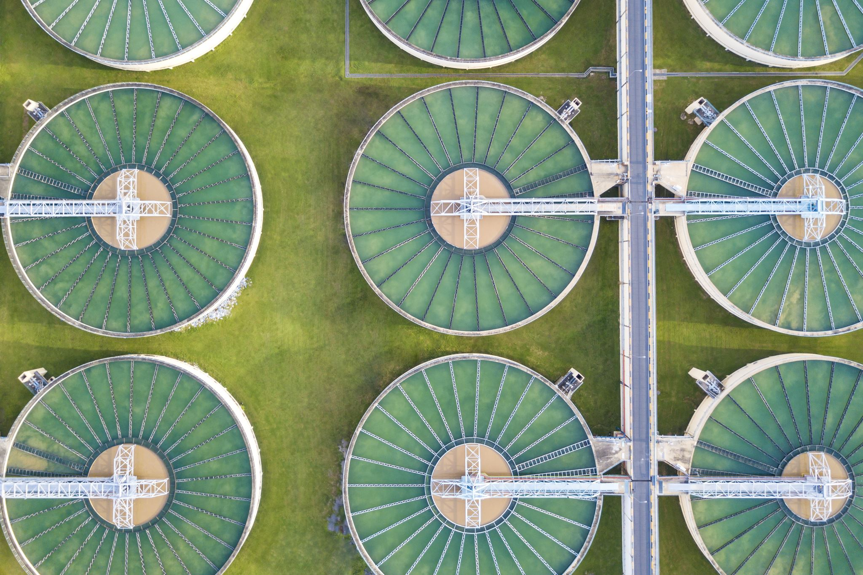
02. Problem & Motivation
Traditional water tanks often require manual monitoring and can lead to water wastage. Our motivation is to enhance convenience, reduce waste, and bring smart technology to water management.

Slide 11

03. Aims & Objectives
Our aim is to create a water tank system that autonomously manages water levels, detects leaks, and optimizes water usage for plants. Objectives include precision, automation, and ease of use.

Slide 12

04. System Overview
At its core, we have the NodeMCU ESP32, the brain of our system. It integrates with rain, water level, leak, and moisture sensors and controls multiple pumps. All managed via the Blynk app.

Slide 13
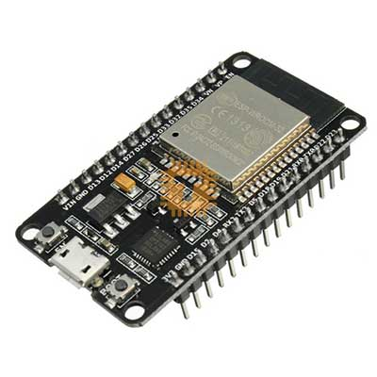
Why node mcu?
Specifications:
WIFI module: ESP32
Processor: ESP32
Built-in Flash: 32Mbit
Antenna: Onboard PCB antenna
Peripheral interface: UART/GPIO/ADC/DAC/SDIO/PWM/I2C/I2S
WiFi protocol: IEEE 802.11 b/g/n
Bluetooth: Bluetooth 4.2
Frequency range: 2.4G ~ 2.5G (2400M ~ 2483.5M)
WIFI mode: Station / SoftAP / SoftAP+Station
Power supply: 5V
Logic level: 3.3V
Dimensions: 51.4mm x 25.4mm

Slide 14
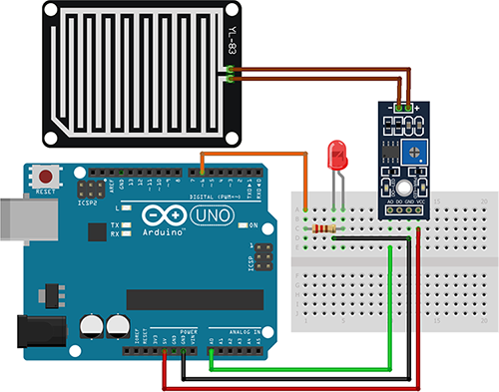

Rain Detection and Pump Management

Slide 15

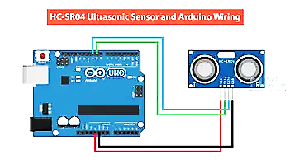
Water Level Management

Slide 16
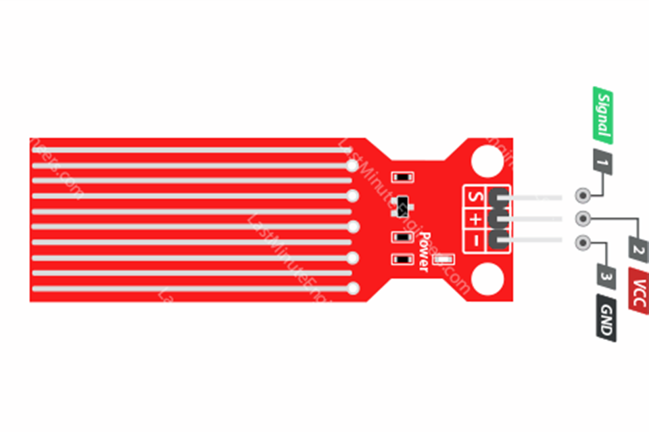
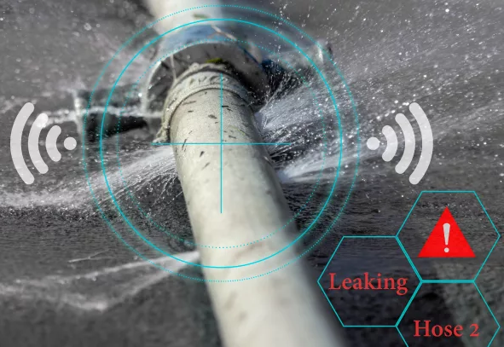
Water Leak Detection

Slide 17
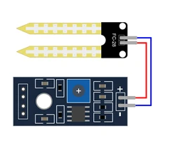
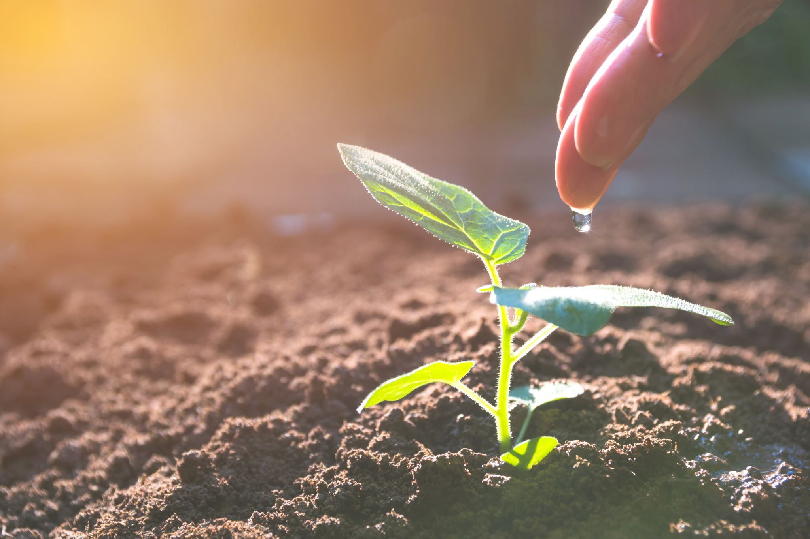
Moisture Sensing for Plants

Slide 18
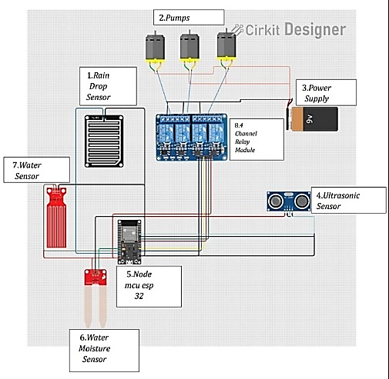
System Circuit and Components

Slide 19
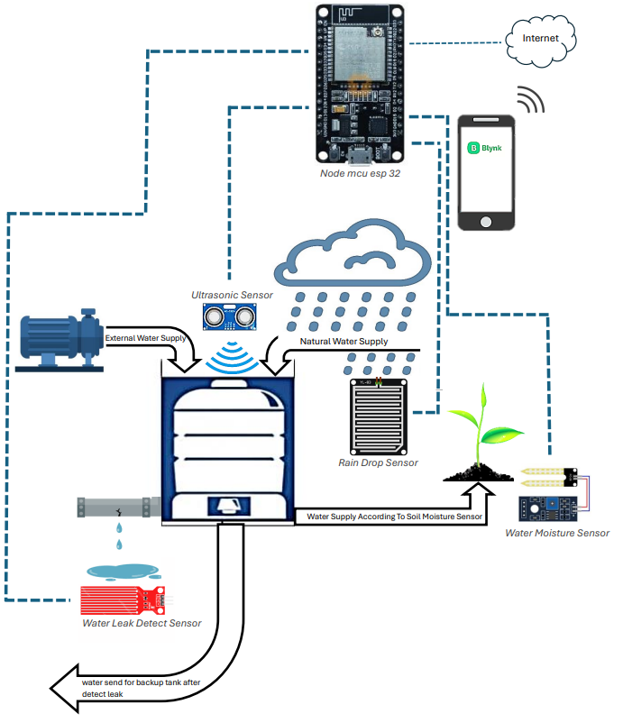
System Diagram

Slide 20

05. Implementation Methodology
The system was developed with careful hardware and software integration, including Blynk app features. Rigorous testing ensured reliable performance.

Slide 21


Node mcu esp32

Slide 22
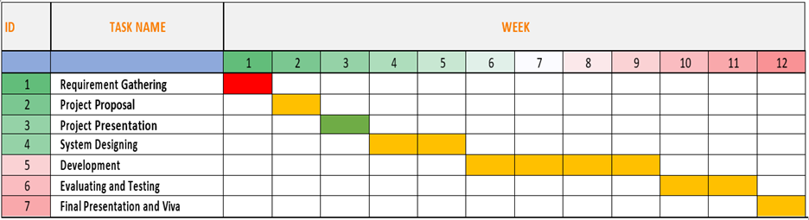
Gantt Chart

Slide 23
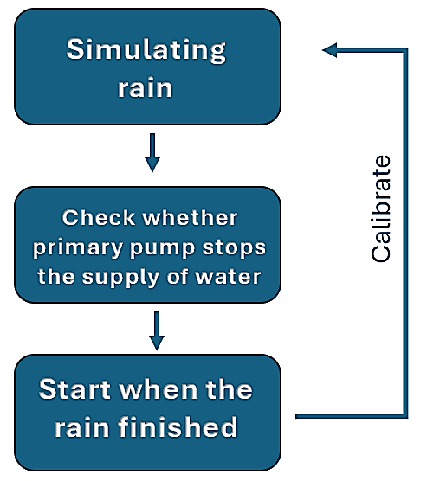
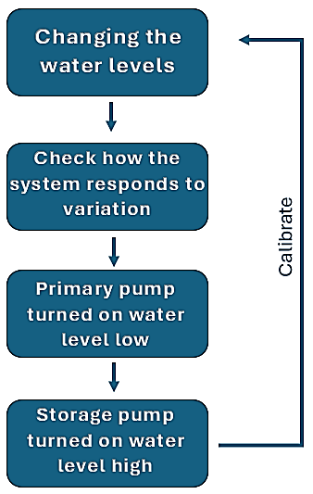
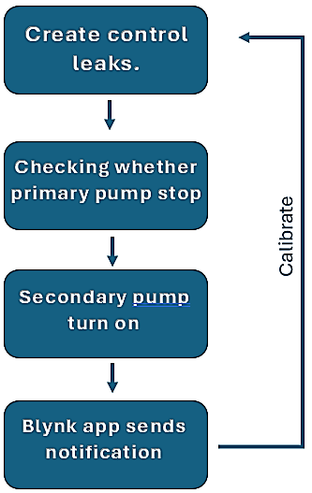
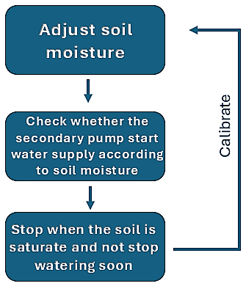
06. Evalution Method
1.Rain drop sensor
2.Ultra sonic sensor
4.. Leak detect sensor
3. Soil moisture sensor

Slide 24
06. Evalution Method
2. Ultra sonic sensor
4.. Leak detect sensor
3. Soil moisture sensor
1.Rain drop sensor

Slide 25
06. Evalution Method
3. Soil moisture sensor
2. Ultrasonic sensor
4.. Leak detect sensor
1.Rain drop sensor

Slide 26
06. Evalution Method
4.. Leak detect sensor
2. Ultrasonic sensor
1.Rain drop sensor
3. Soil moisture sensor

Slide 27

07. Conclusion and Q&A
Our Smart Water Tank System represents the future of water management intelligent, efficient, and user-friendly. We welcome your questions and feedback.

Slide 28
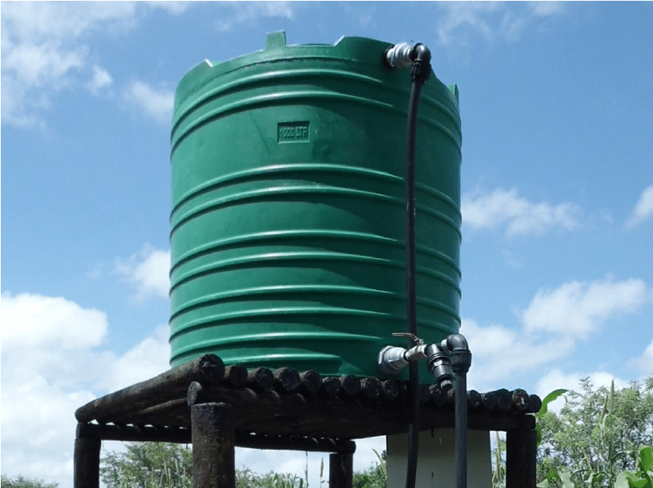
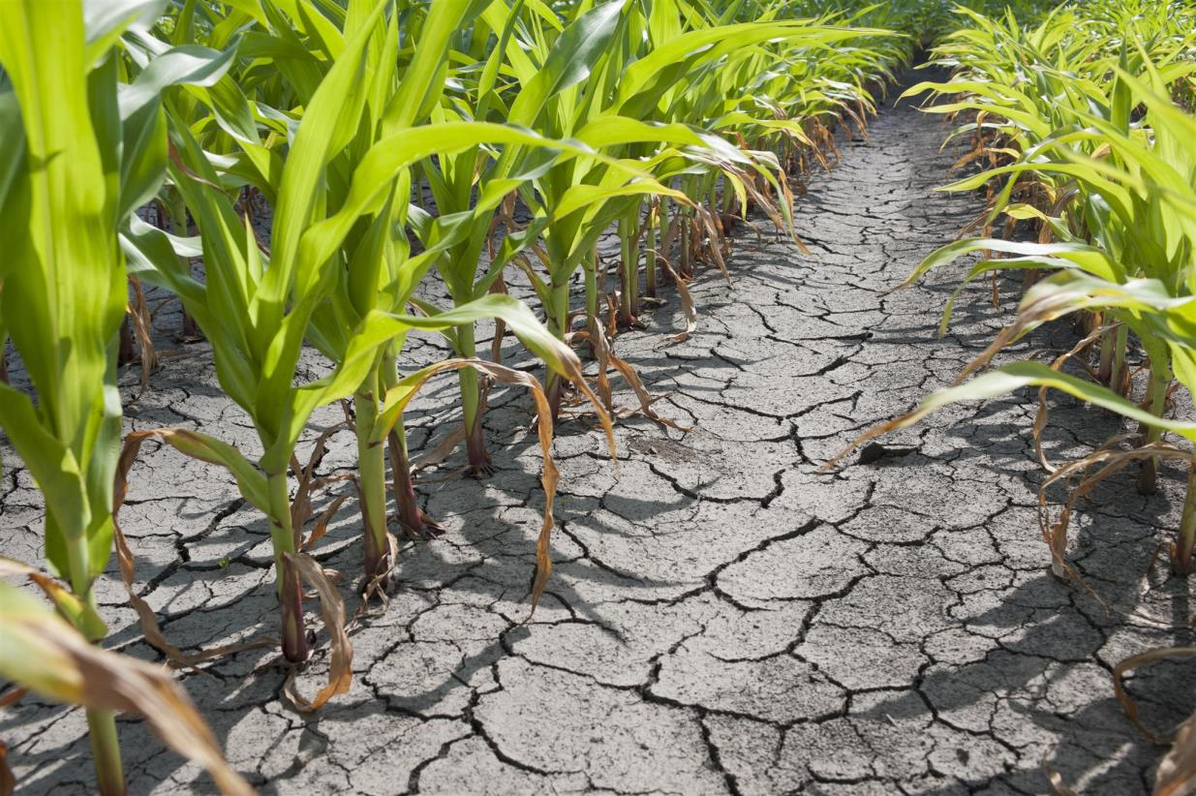
Water shortage
Inefficient irrigation methods

Slide 29
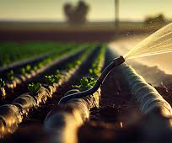
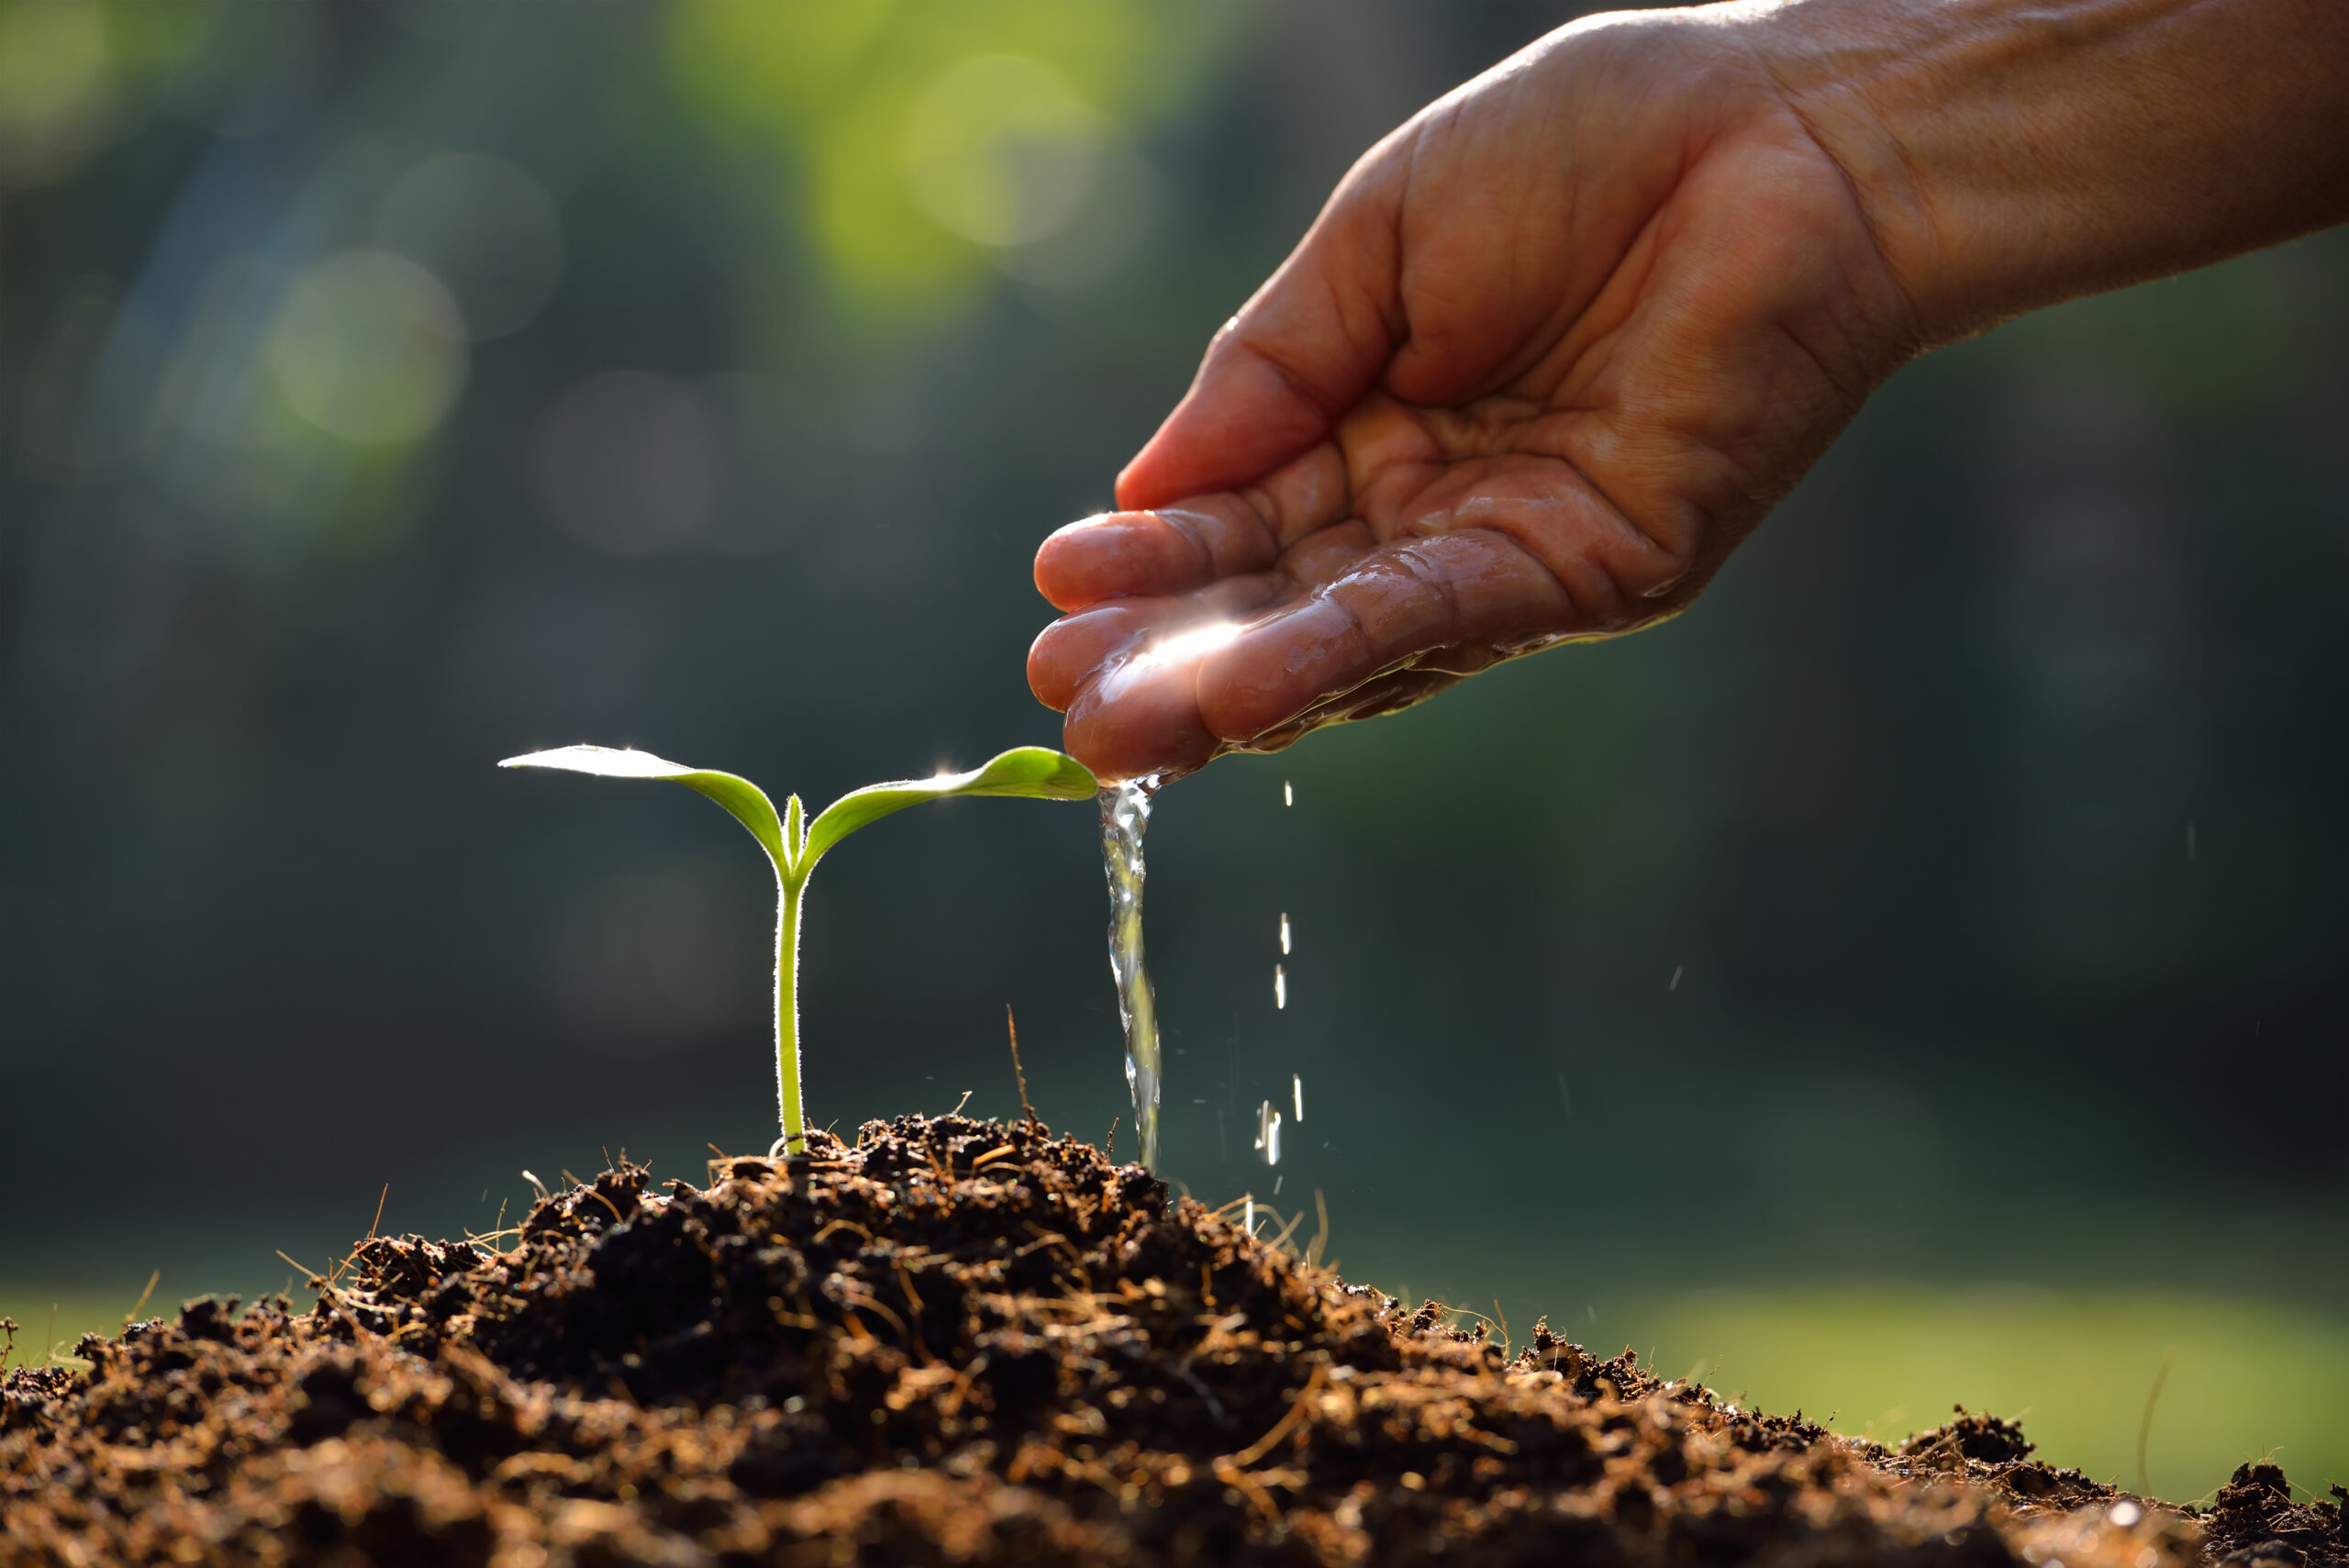

Minimizes wastage of water
Accurate water management
Increases crop yield

Slide 30
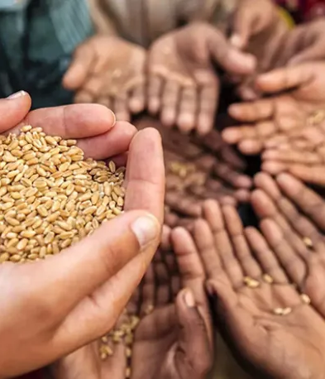
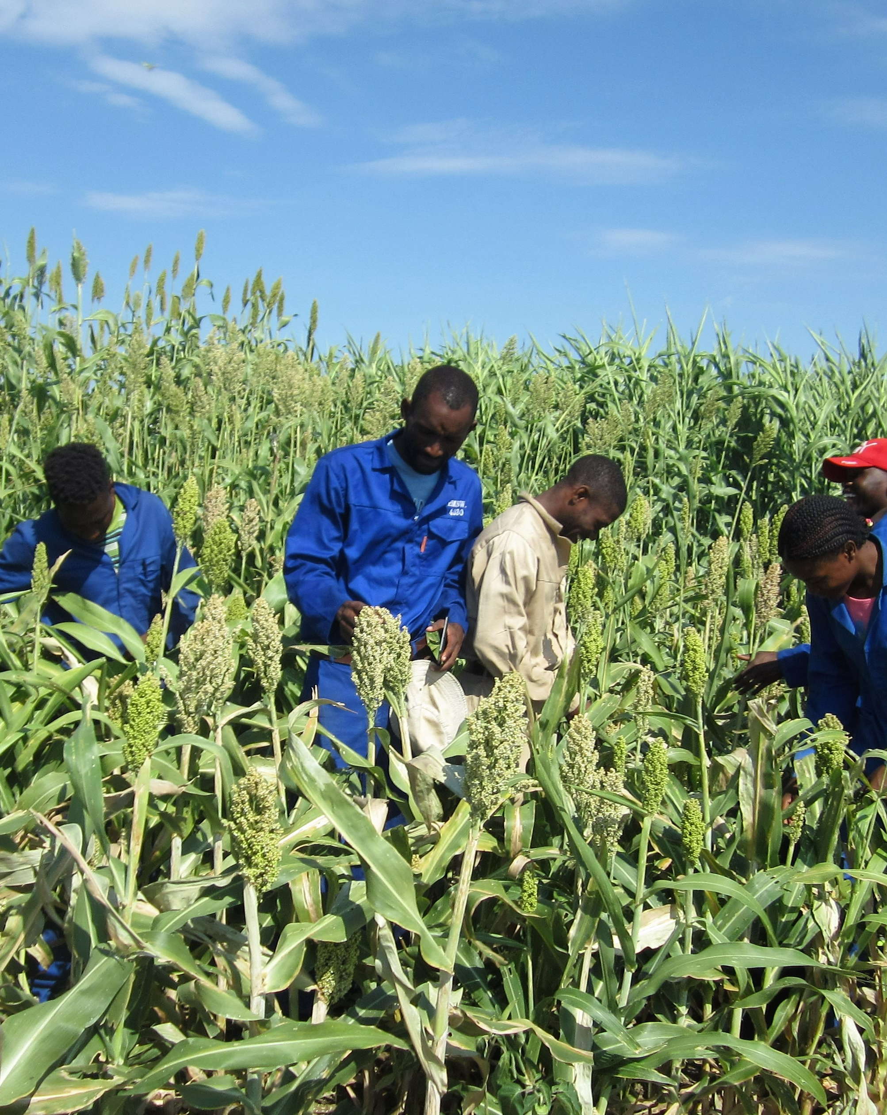

FamilyID=Office_ArchiveTorn
Provide food security
Increase farmers’ productivity
Protect valuable resources

Slide 31

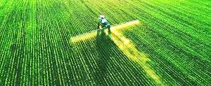
Let us unleash technology in the service of a more sustainable and prosperous future.

Slide 32
08. Reference
USDA's Inefficient Use of Irrigation Water: This report provides a comprehensive overview of the issue, including its impacts and potential solutions: https://efotg.sc.egov.usda.gov/references/public/AR/Excess_Water_Insufficient_Water_Inefficient_Use_of_Irrigation_Water.pdf
The Water Project: Water Scarcity and Agriculture: This article discusses the impact of water scarcity on agriculture and the role of irrigation management: https://thewaterproject.org/water-scarcity/water-scarcity-and-agriculture
ResearchGate: Irrigation management under water scarcity: This research paper delves deeper into irrigation management strategies in water-scarce regions: https://www.researchgate.net/publication/223843129_Irrigation_management_under_water_scarcity

Slide 33
THANK YOU

